Slide 1

JavaScript
Lesson 4

Slide 2
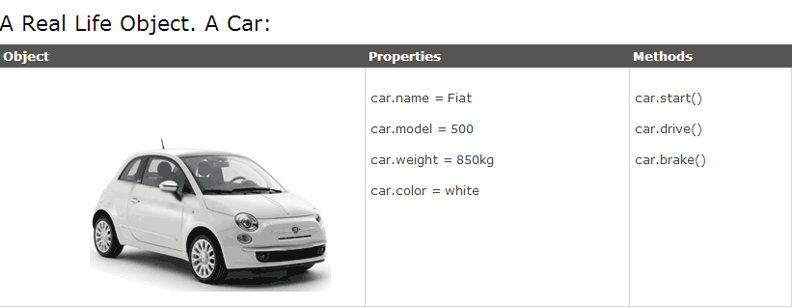
Objects
Almost everything in JavaScript can be an Object: Strings, Functions, Arrays, Dates....
Objects are just data, with properties and methods.
The properties of the car include name, model, weight, color, etc.
The methods of the car could be start(), drive(), brake(), etc.

Slide 3
Objects in JavaScript:
var txt = new String("Hello World");

Slide 4
Strings(quotes, index)
A string can be any text inside quotes. You can use single or double quotes:
var carname="mercedes";
var carname= 'mercedes';
You can access each character in a string with its position (index):
var character=carname[5]; //d
You can use quotes inside a string, as long as they don't match the quotes surrounding the string:
var answer="He is called 'Johnny'";
var answer='He is called "Johnny"';

Slide 5
Strings(length, indexof)
The length of a string (a string object) is found in the built in property length:
var txt="Hello World!";
document.write(txt.length);
The indexOf() method returns the position (as a number) of the first found occurrence
of a specified text inside a string:
var str="Hello world, welcome to the World.";
var n=str.indexOf("welcome");
alert(n);

Slide 6
Strings(replace, upper/lower)
The replace() method replaces a specified value with another value in a string.
var message="Please visit Microsoft!";
var n= message.replace("Microsoft","W3Schools");
// n="Please visit W3Schools!";
A string is converted to upper/lower case with the methods toUpperCase() /
toLowerCase():
var norm="Hello World!";
var up_norm= norm.toUpperCase(); //HELLO WORLD!
var low_norm= norm.toLowerCase(); //hello world!

Slide 7
Strings(split,substr)
A string is converted to an array with the built in method string.split():.
var alph="a*b*c*d*e*f";
var n= alph.split("*"); // ("a", "b", "c", "d", "f")
The substr() method extracts parts of a string, beginning at the character at the specified position, and returns the specified number of characters.
var x= "Hello world!";
var res = x.substr(1,4) ; // ello
var y= x.substr(2); // llo world!

Slide 8

Task 1:
"javascript" տողը գրված է տառերի անհայտ հերթականությամբ:Անհրաժեշտ է բոլոր տառերը փոխարինել համապատասխան հայերեն տառով:

Slide 9
Task 2:
Սահմանել մեկ պարամետրանի ֆունկցիա,որը վերադարձնում է տրված բառը՝ գրված տառերի հակառակ հերթականությամբ:

